Slide 1
MIS 321
Abstract Classes

Slide 2
Abstract Classes
The abstract modifier indicates that the thing being modified has a missing or incomplete implementation.
The abstract modifier can be used with classes, methods, properties, etc.
An abstract class is a class with the abstract modifier indicating the class is incomplete.
An abstract class by definition can not be instantiated. It must be used as a parent class.

Slide 3
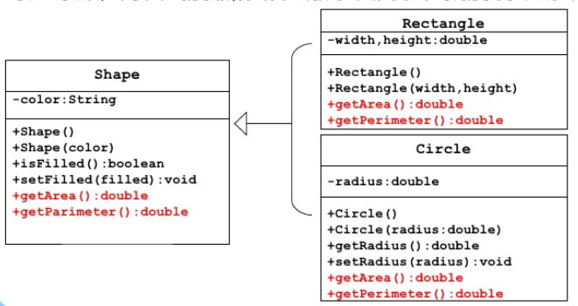
Abstract Classes
Abstract classes are easiest understood looking at an example. Let’s return to the shapes example we looked at previously.

Slide 4
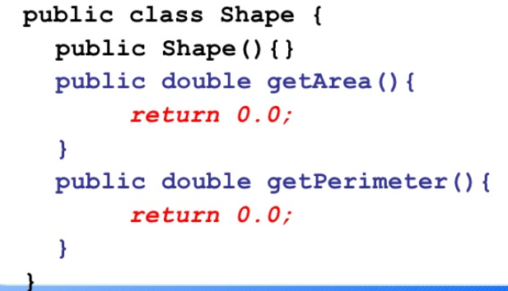
Abstract Classes
If every shape should have an area and perimeter, what should the implementation of the getters be in the shape class?

Slide 5
Abstract Class – Why do we need it?
There are common implementations such as color and filled that I want to inherit.
But now I must remember to override the GetArea and GetPerimeter methods in every subclass created….. Lot’s of potential for error….
If we have some methods that must be overridden we can make the method abstract.
If a method is abstract the class must be abstract.

Slide 6
Abstract Class
Abstract classes are similar to other classes, but is has the keyword abstract
Any method that must be overridden in its subclasses must also have the abstract keyword.
Unlike an interface, abstract classes can have normal properties, fields, methods, etc.

Slide 7
Sample Abstract Class
public abstract class Shape
{
private string color;
public Shape()
{
}
public string GetColor()
{
return color;
}
public void SetColor(string color)
{
this.color = color;
}
public abstract double GetArea();
public abstract double GetPerimeter();
}

Slide 8
Sample Class Inheriting from Abstract
public class Square : Shape
{
public double Side {get; set;}
public override double GetArea()
{
return Side * Side;
}
public override double GetPerimeter()
{
return 4* Side;
}
}
static void Main(string[] args)
{
Shape myShape = new Square(){Side = 5};
myShape.SetColor("Blue");
Console.WriteLine(myShape.GetArea());
}

Slide 9
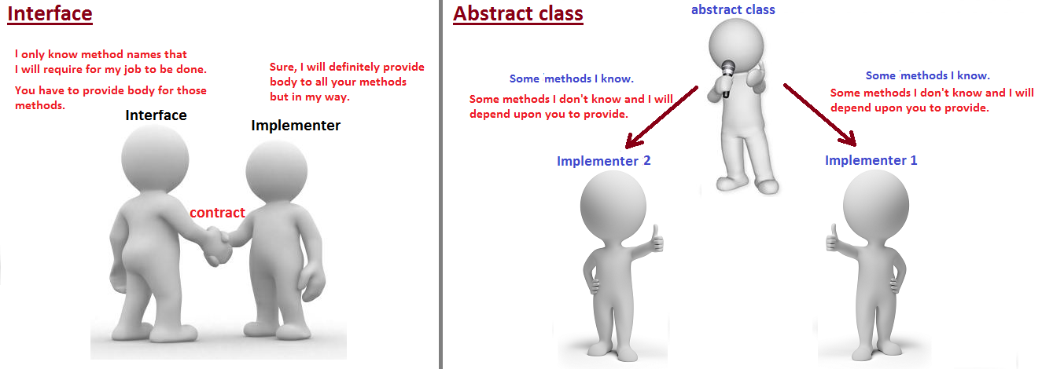
Interface Vs Abstract Class
Abstract Class | Interface
Does not provide full abstraction | Provides full abstraction
Can not achieve multiple inheritance | Can achieve multiple inheritance
Can declare a member field | Can not declare a member field
Can provide complete, default code or just provide the signature that must be overridden | Can not provide any code, just the signatures

